Slide 1
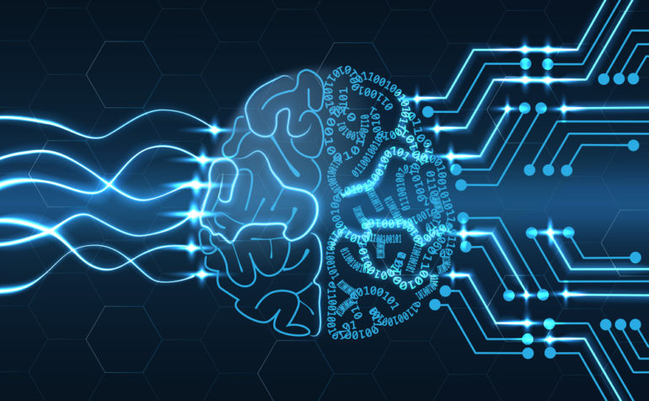
Machine Learning
University College of Engineering
Villupuram
Esakki Muthu Velraja M
B-Tech IT

Slide 2
Machine Learning
Machine learning is a type of artificial intelligence (AI) that provides computers with the ability to learn without being explicitly programmed.
Machine learning focuses on the development of computer programs that can teach themselves to grow and change when exposed to new data.
Machine Learning

Slide 3
Machine Learning
Automating automation
Getting computers to program themselves
Writing software is the bottleneck
Machine Learning

Slide 4
Difference between traditional programming and machine learning
Traditional Programming
Data
Programs
Machine Learning
Data
Output
Computer
Output
Computer
Program
Machine Learning

Slide 5
Supervised Learning
Supervised Learning is a type of machine learning that feeds a computer system many(thousand,millions) of examples of a given item and having the computer calculate the similarities between those items so that can recognize other examples of that items which it has not seen yet.
Machine Learning

Slide 6
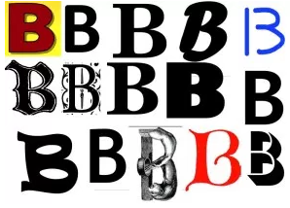
Supervised Learning Example
Machine Learning

Slide 7
Unsupervised learning
Unsupervised learning algorithms can perform more complex processing tasks than supervised learning systems. However, Unsupervised learning can be more unpredictable than the alternative model.
Machine Learning

Slide 8
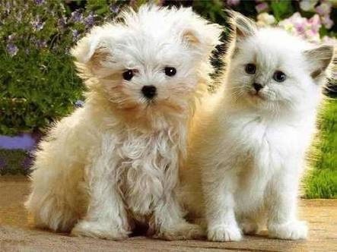
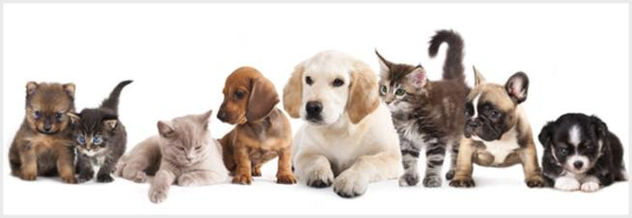
Unsupervised learning Example
Sort Cats from Dogs
Machine Learning

Slide 9
Reinforcement learning
Reinforcement learning is a type of machine learning that tells a computer if it has made the correct decision or wrong decision.
With enough iterations a reinforcement learning system will eventually be able to predict the correct outcomes and therefore make the “correct decision”.
Machine Learning

Slide 10
Advantages of Machine Learning
ML is used in different applications such
as Banking,Financial sector,Robotics,Games…..
Automations of tasks.
Machine Learning

Slide 11
Disadvantages of Machine Learning
Problems with verifications
Error diagnosis and correction
Acquisition of relevant data is the
major challenge
Machine Learning

Slide 12
Applications
Siri and Cortana
Google Maps
Google Search
Facebook
Paypal
Radiology and Radiotherapy
Smart Electronic Health
Records
Games
Robotics
Machine Learning

Slide 13
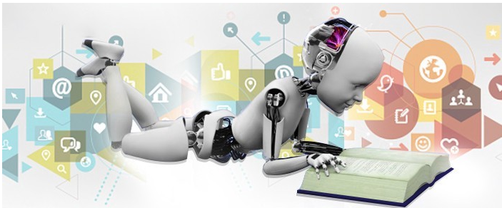
Machine Learning
Thank You

